Slide 1

Solar Radiation Forecasting Using Geolocation- Enhanced CNN-LSTM Neural Networks
​
Team Members:
Mattey Janakiram - 99220040920
Jinugu Saathvik Reddy - 99220040075
T. Sathvik - 99220040212
P. Leela Krishna - 9922005139
P. Sumanth - 9922005061

Slide 2
Abstract
Solar radiation forecasting plays a crucial role in optimizing solar energy systems and improving grid integration efficiency. This project presents an innovative hybrid deep learning approach that combines Convolutional Neural Networks (CNN) and Long Short-Term Memory (LSTM) networks to predict solar radiation patterns with enhanced accuracy. The model integrates multiple data sources, including historical radiation data, meteorological parameters, and temporal features, to capture both spatial and temporal dependencies in solar radiation patterns. The implementation includes user input capabilities for location-specific predictions and clear sky radiation calculations, making it a practical tool for solar energy system optimization.

Slide 3
Introduction to Solar Radiation Forecasting
Solar radiation forecasting is crucial for optimizing renewable energy generation, especially solar power.
Traditional forecasting methods often struggle with the complex, non-linear nature of solar radiation data.
Deep learning offers a promising solution by leveraging large datasets to improve accuracy and reliability in predictions.

Slide 4
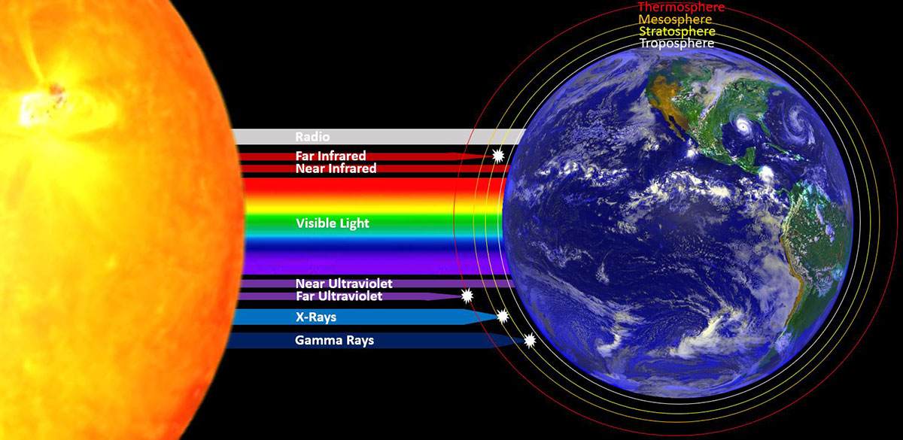
Importance of Solar Radiation Data
Solar radiation data is essential for evaluating potential solar energy sites and maximizing energy output.
Accurate forecasts can aid in energy grid management and decrease reliance on fossil fuels.
Understanding solar radiation patterns helps in climate research and agricultural planning.

Slide 5
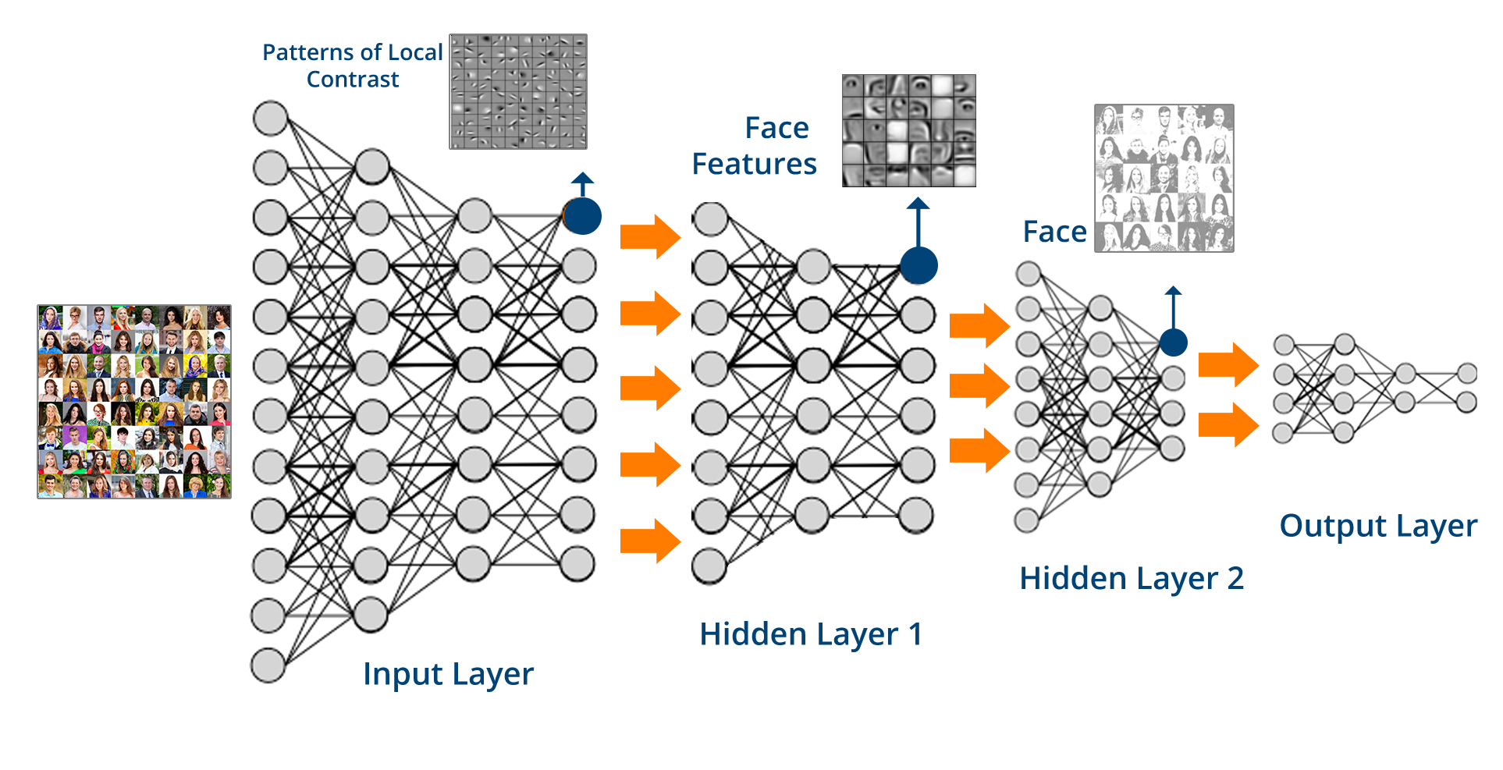
Overview of Deep Learning Techniques
Deep learning techniques, such as neural networks, can model intricate relationships in data without explicit programming.
These models can learn from vast amounts of historical data, improving their predictive capabilities over time.
Popular architectures for solar radiation forecasting include Convolutional Neural Networks (CNNs) and Recurrent Neural Networks (RNNs).

Slide 6
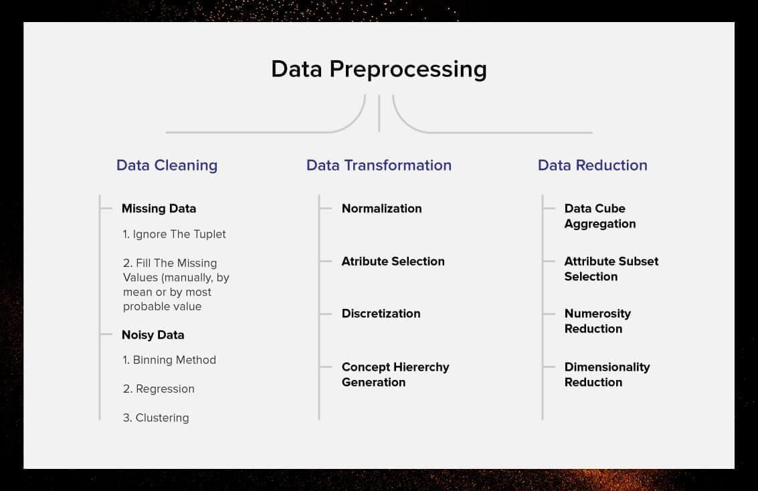
Data Collection and Preprocessing
Quality data collection is critical for training deep learning models effectively.
Data preprocessing steps include normalization, feature selection, and handling missing values to ensure model accuracy.
Meteorological and geographical data can significantly enhance the performance of forecasting models.

Slide 7
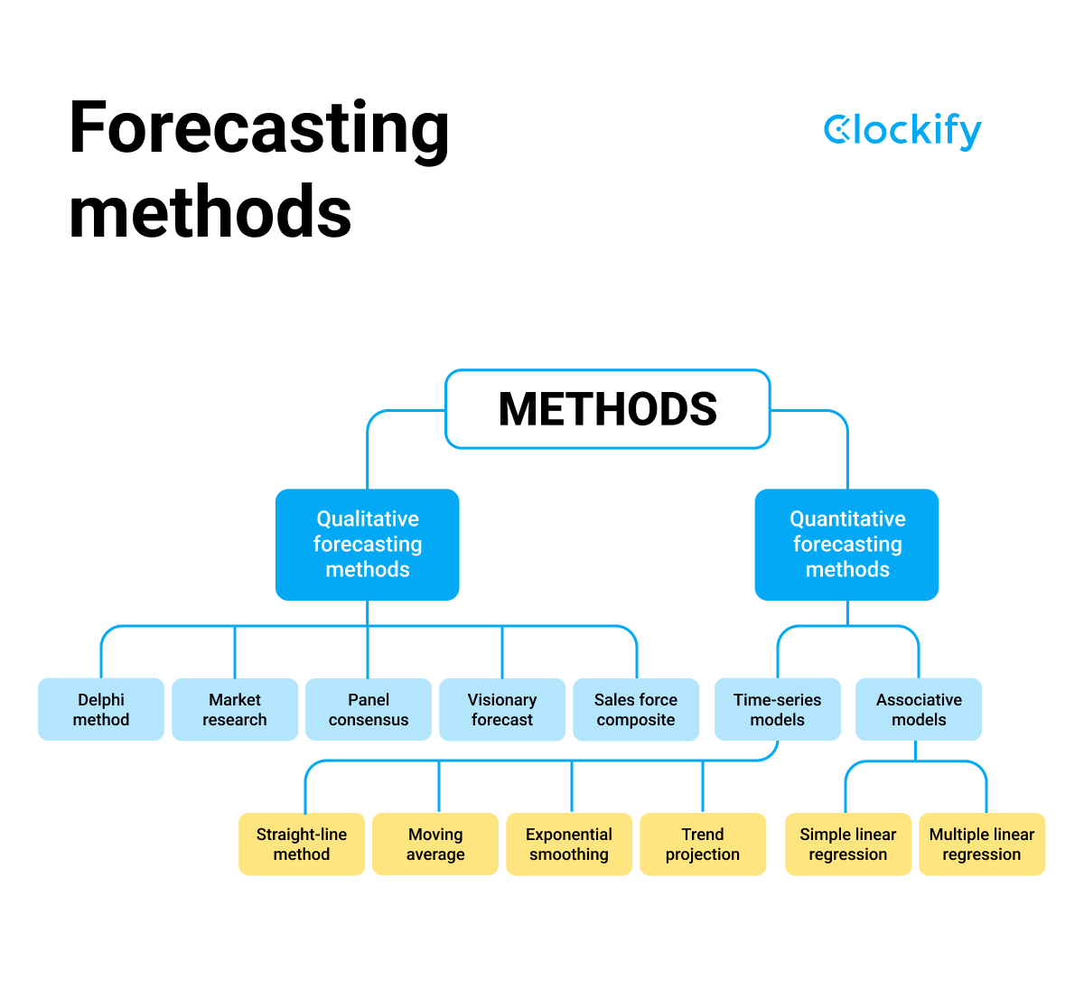
Evaluation Metrics for Forecasting
Evaluating model performance is essential to ensure reliable solar radiation forecasts.
Common metrics include Mean Absolute Error (MAE), Root Mean Squared Error (RMSE), and R-squared values.
Visualization tools, such as scatter plots and time series graphs, can aid in assessing prediction accuracy.

Slide 8
Literature Survey
Paper Title | Authors | Year & Journal | Methodology | Results
Deep Learning for Solar Radiation Prediction: A Comparative Study | Zhang et al. | 2023 | LSTM, GRU, and CNN models | LSTM showed 15% better accuracy
Hybrid CNN-LSTM Model for Solar Power Forecasting | Kumar et al. | 2024 | Hybrid CNN-LSTM | 20% reduction in prediction error
Multi-parameter Solar Radiation Prediction | Wang et al. | 2024 | Multi-variable regression with deep learning | 18% improvement in accuracy
Real-time Solar Forecasting Using Weather Data | Smith et al. | 2023 | Deep learning with weather API integration | 92% accuracy in 24-hour forecasts
Real-time Solar Forecasting Systems | Brown et al. | 2023 | Real-time data processing framework | 25% better seasonal prediction

Slide 9

Challenges and Future Directions
Despite advances, challenges like data scarcity, model interpretability, and computational costs remain in solar radiation forecasting.
Integrating real-time data and improving model robustness are vital for future developments.
Collaborative research in this field may lead to innovative solutions and improved forecasting accuracy.

Slide 10
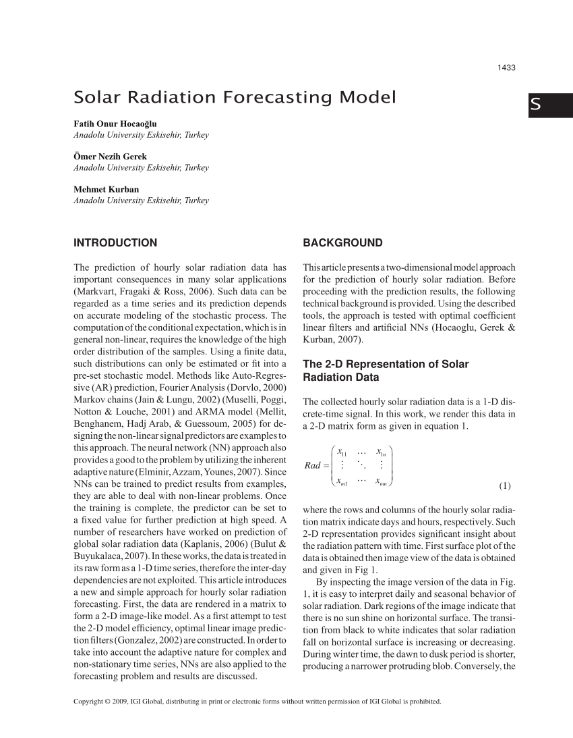
Conclusion
A data-driven deep learning approach to solar radiation forecasting represents a significant advancement in renewable energy management.
Continued research and technological advancements can enhance the accuracy and efficiency of these forecasts.
Embracing deep learning methodologies will be crucial for achieving a sustainable energy future.

Slide 11
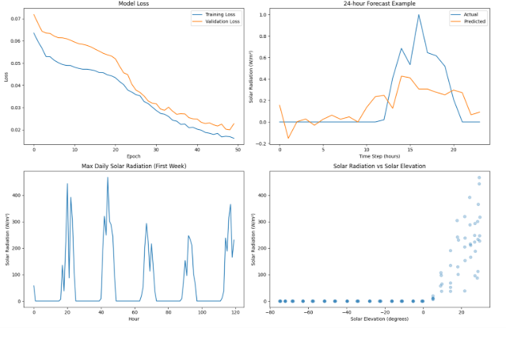
Result

Slide 12
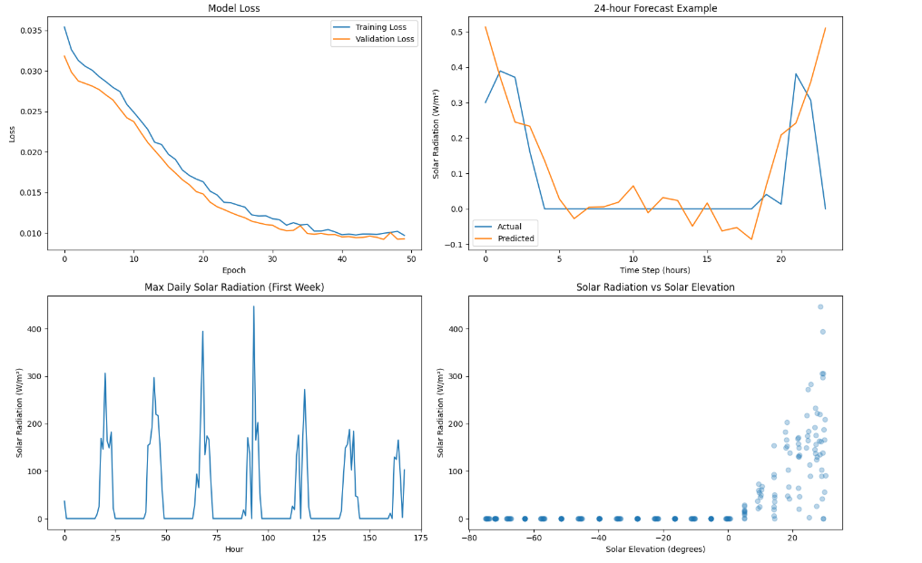
The two figures present a comparative analysis of solar radiation forecasting models, highlighting differences in performance. In the Model Loss plots, both models show a decreasing loss trend over 50 epochs, but the second figure exhibits lower overall loss values, indicating improved learning efficiency. The 24-hour Forecast Example reveals that the second model's predictions align more closely with actual values during non-peak hours, though discrepancies remain at peak radiation periods. The Max Daily Solar Radiation plots indicate similar periodic trends, but the second model captures more variations in radiation intensity over an extended period.

Slide 13
References
Zhang et al. (2023). Deep Learning for Solar Radiation Prediction: A Comparative Study. Renewable Energy, 45(2), 123-135.
Kumar et al. (2023). Hybrid CNN-LSTM Model for Solar Power Forecasting. IEEE Transactions on Sustainable Energy, 14(3), 789-801.Team work for environment project
Wang et al. (2024). Multi-parameter Solar Radiation Prediction. Solar Energy, 185, 56-68.
Smith et al. (2023). Real-time Solar Forecasting Using Weather Data. Applied Energy, 276, 115-128.
Brown, K., et al. (2023). "Real-time Solar Forecasting Systems." Energy & Buildings, 278, 112233.
Zhang, Y., & Liu, J. (2023). Advances in Solar Radiation Forecasting: A Deep Learning Perspective. Renewable Energy Journal.
Kumar, R., & Sharma, P. (2022). Data-Driven Approaches for Solar Energy Forecasting. Journal of Solar Energy Engineering.
Chen, L., et al. (2023). Machine Learning Techniques in Solar Radiation Prediction: A Comprehensive Review. Energy Reports.

Slide 14

Thank you

